Slide 1
Beanstalk
Milestone 4
Terry Yang, Annie Lin,
Hiroka Tamura, Kaelan Mikowicz

Slide 2
Beanstalk - Share your adventure
Bring people together around trendy spots and hidden gems!

Slide 3
Outline
New Features
UI Design: High Fidelity Comparisons
Future Features: Wishlist
Live Demo

Slide 4
New Features
Hashtags
Notifications
Map
Frontend and Backend Overview

Slide 5
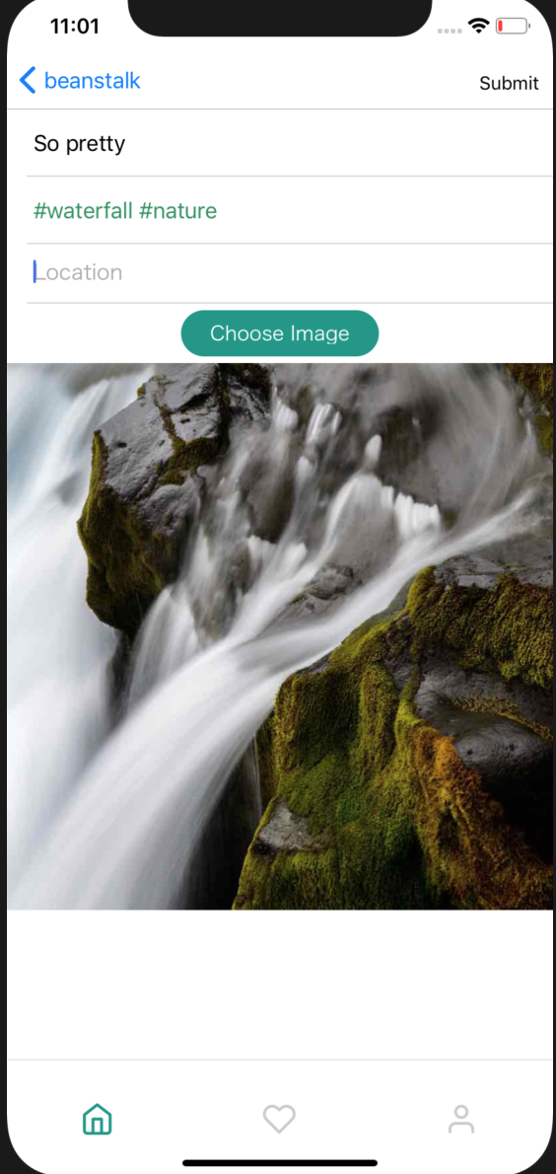
Hashtags: Frontend
Post Creation with Hashtags:
User includes hashtags when creating a post
Color change on UI
A post can be tagged with multiple hashtags
The backend will parse and extract valid hashtags
Notes:
talk abt the color change

Slide 6
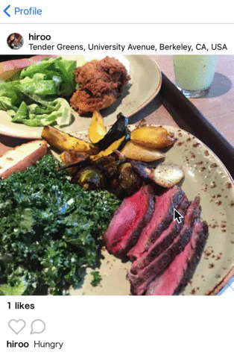
Hashtags on Post
Associated hashtags show on image click.
If there’s a long list, there will be a horizontal scroll view.
Notes:
you can see hashtags when you click on pic

Slide 7
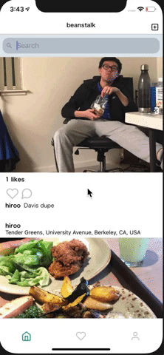
Hashtags: Frontend
Hashtags Search:
Hashtags displayed with other search results for usernames and locations
Hashtag results begin with a “#”
Perform GET requests for search results
display based on search result type
Notes:
Annie? talk abt icon, and specific result

Slide 8
Hashtags: Frontend
Retrieving Posts with Hashtag:
Displays posts with a specific hashtag by
Clicking on a search result
Clicking on a hashtag on a post
Hashtag Page Component
Perform GET request to Hashtag endpoint with specific hashtag
Renders posts with specific Hashtag
Notes:
annie

Slide 9
Hashtags: Backend
Post Endpoint - /api/Post
POST - Creates a new post for auth user.
New: Parse and store hashtags info
Search Endpoint - /api/User/search?query=<query_string>
GET - Retrieves a list of likely usernames for <query_string>.
New: Also retrieves a list of likely hashtags for <query_string>
New: Hashtag Endpoint - /api/Hashtag?hashtag=<hashtag>
GET - Retrieves the posts tagged with <hashtag>

Slide 10
Hashtags: Search Query
Input: hashtag string without the leading ‘#’
SELECT id, hashtag.hashtag
FROM hashtag
WHERE hashtag.hashtag LIKE #fun%

Slide 11
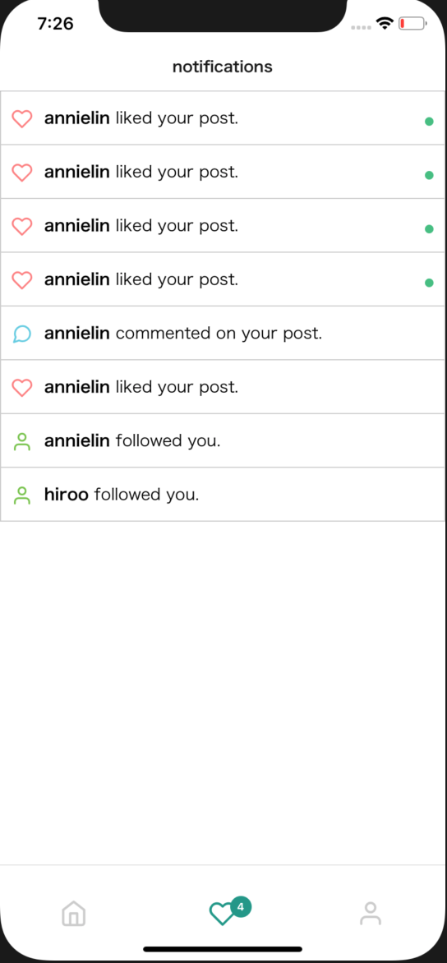
Notifications: Frontend
How Notifications are Triggered:
Like or Comment on Post, Follow User
Three types of notifications are displayed
A comment on a post by the user
A like on a post by the user
A new follower for the user
Loading Notification Feed
Perform GET request to Notification endpoint
Notes:
annie, talk about icons

Slide 12
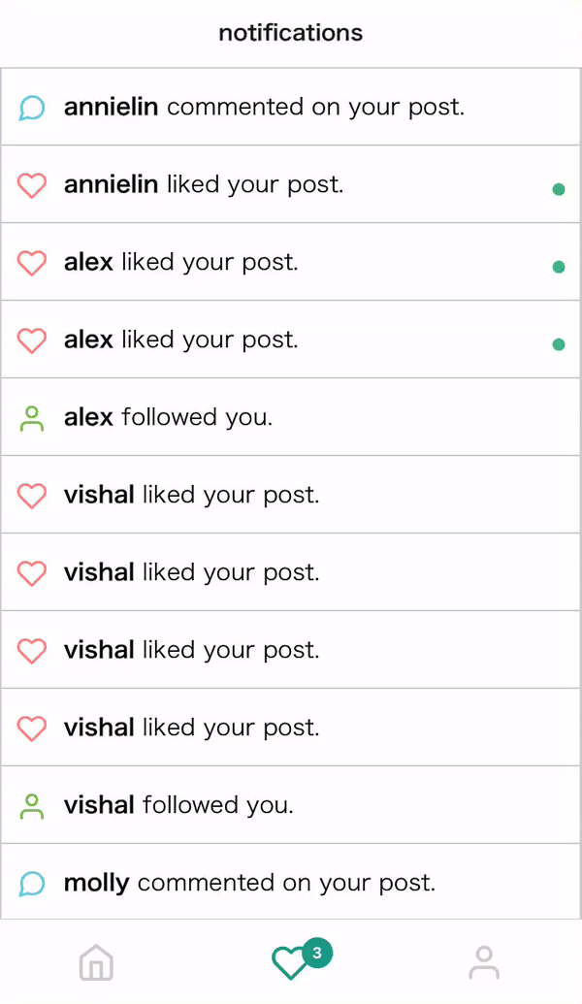
Notifications: Frontend
Notification Badges
Make query to notifications backend
Count the number of unread notifications based on read field
Update badge whenever a notification is read

Slide 13
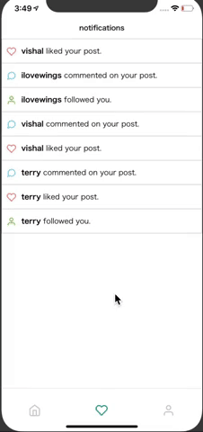
Notifications: Frontend
Notifications Navigation:
Clicking on a comment notification or like notification displays the related post
Clicking on a follow notification displays the new follower’s profile
Implementation:
Navigate based on notification type found in backend
Notes:
annie, talk abt passing in props

Slide 14
Notifications: Backend
Post Comment Endpoint - /api/Post/<pid>/comment
POST - Creates a new comment for auth user on post with <pid>.
New: Stores a comment notification for owner of post with <pid>
Post Like Endpoint - /api/Post/<pid>/like
POST - Lets auth user like the post with <pid>.
New: Stores a like notification for owner of post with <pid>

Slide 15
Notifications: Backend
User Follow Endpoint - /api/User/follow/<username>
POST - Lets the auth user follow the user with <username>.
New: Stores a follow notification for user with <username>
New: User Notification Endpoint - /api/User/Notification
GET - Retrieves all notifications for auth user
New: User Notification Read Endpoint - /api/User/Notification/<id>
POST - Mark notification with <id> as read

Slide 16
Notifications Table
CREATE TABLE public.notification
(
id integer NOT NULL DEFAULT nextval('notification_id_seq'::regclass),
uid integer,
message character varying(300) NOT NULL,
notif_type character varying(1) NOT NULL,
link character varying(64) NOT NULL,
read boolean NOT NULL,
"timestamp" timestamp without time zone NOT NULL,
CONSTRAINT notification_pkey PRIMARY KEY (id),
CONSTRAINT notification_uid_fkey FOREIGN KEY (uid)
REFERENCES public."user" (id) MATCH SIMPLE
ON UPDATE NO ACTION
ON DELETE SET NULL
)

Slide 17
Notifications Query
SELECT message, notif_type, link
FROM notification
WHERE uid = <user_id>
ORDER BY “timestamp” DESC
UPDATE notification
SET read = true
WHERE uid = <auth_user.id> AND id = <notification_id>

Slide 18
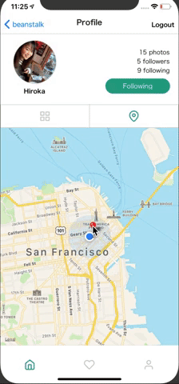
Map: Frontend
User Profile Map with Post Pins:
Every user profile contains an interactive map with pins for posts made by the user at that location
Clicking on a pin displays all the user’s posts at that location
Location added with Google Maps autocomplete API
Notes:
kaelan

Slide 19
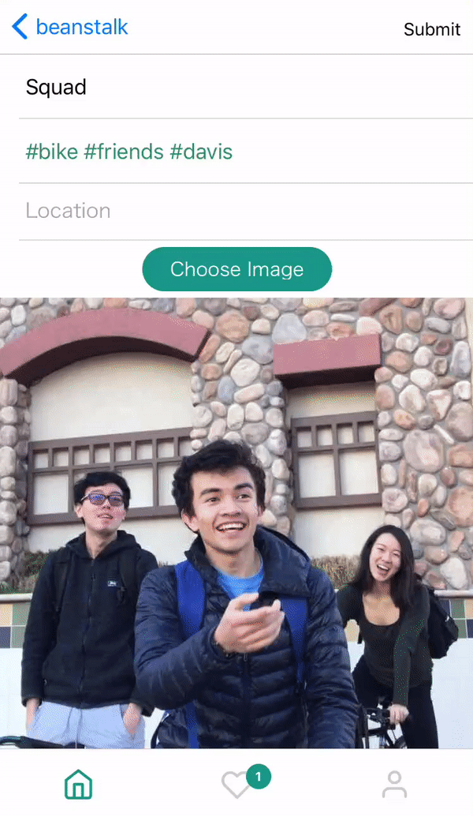
Location Autocomplete
Google Places Autocomplete
When user adds a post, the locations input will provide a list of existing locations provided by google maps
Google Maps API key
Can retrieve location details. In our case we store:
Place Name
Latitude/Longitude

Slide 20
Map: Frontend
Locations Search:
Locations displayed with other search results for usernames and hashtags
Location results begin with specific icon
Perform GET request to Search endpoint

Slide 21
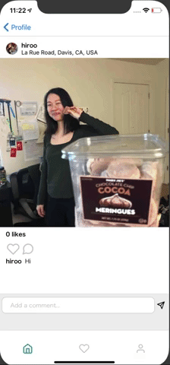
Map: Frontend
Retrieving Posts with Location:
Displays map with pin at location and posts made by all users at location by
Clicking on a search result
Clicking on a location on a post

Slide 22
Map: Backend
Post Endpoint - /api/Post
POST - Creates a new post for auth user.
New: Stores place name, latitude and longitude for location
Search Endpoint - /api/User/search?query=<query_string>
GET - Retrieves a list of likely usernames for <query_string>.
New: Also retrieves a list of likely place names for <query_string>

Slide 23
Map: Backend
New: Location Endpoint - /api/Location?id=<id>
GET - Retrieves the posts at location with <id>
New: Location Endpoint - /api/Location?id=<id>&username=<username>
GET - Retrieves the posts at location with <id> for user with <username>

Slide 24
Map Query Posts at Location
SELECT id, photo
FROM post
WHERE lid = <location_id>
ORDER BY “timestamp” DESC

Slide 25
UI Design:
High Fidelity Comparisons
Login Page
Registration Page
Activity Feed
Notifications Feed
User Profile
Profile Map
Our Additions
UX Features
Requirements Fulfillment and
Extra Additions

Slide 26
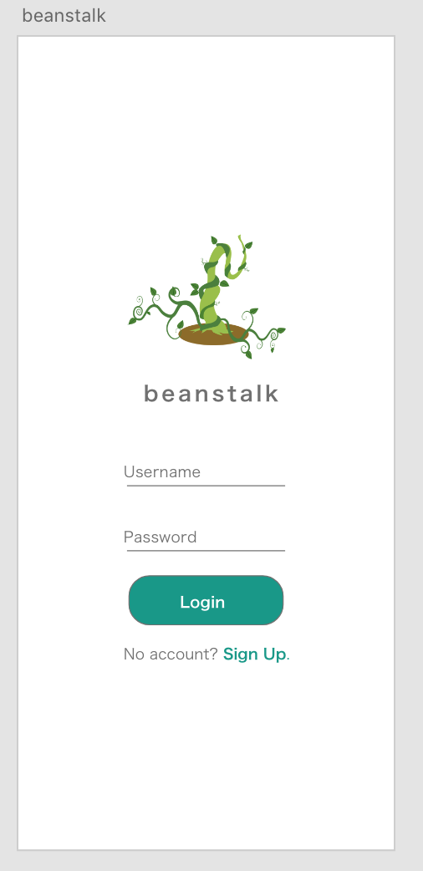
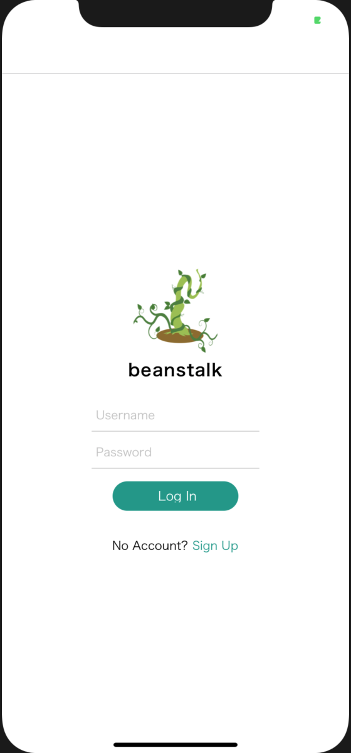
Login Page
Design: App:

Slide 27
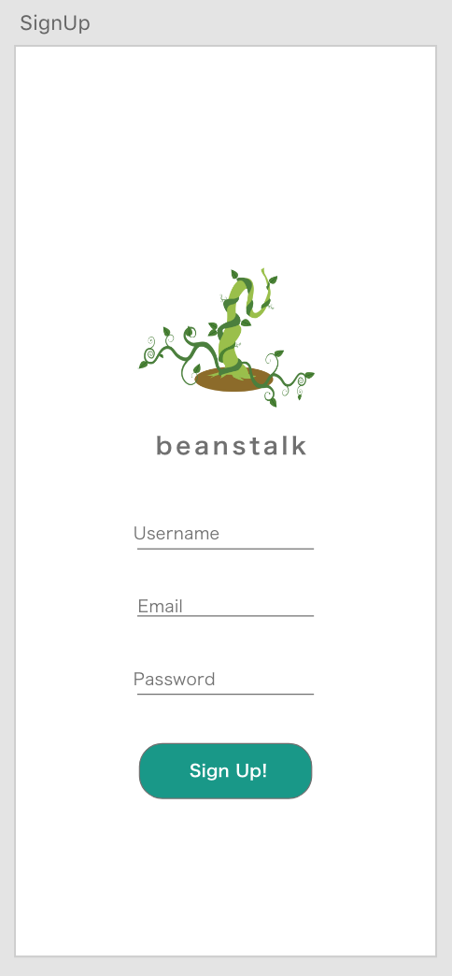
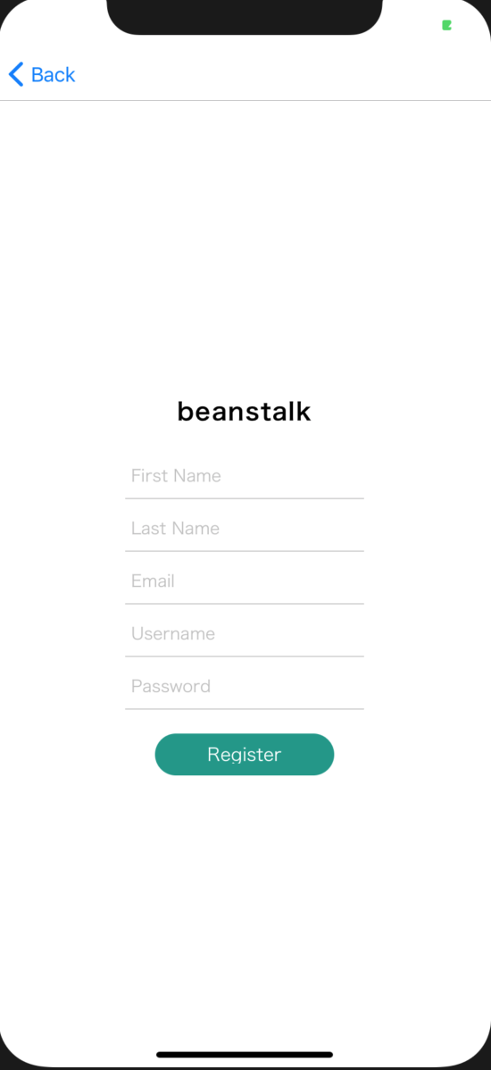
Registration Page
Design: App:

Slide 28
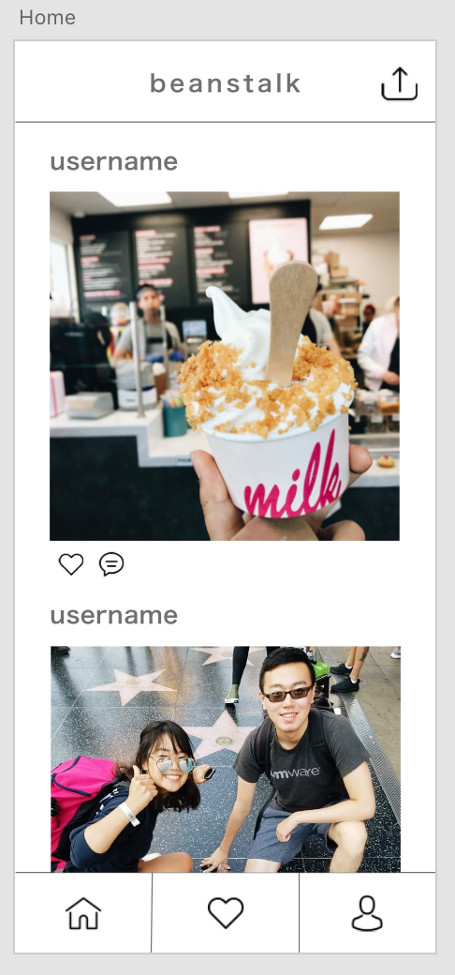
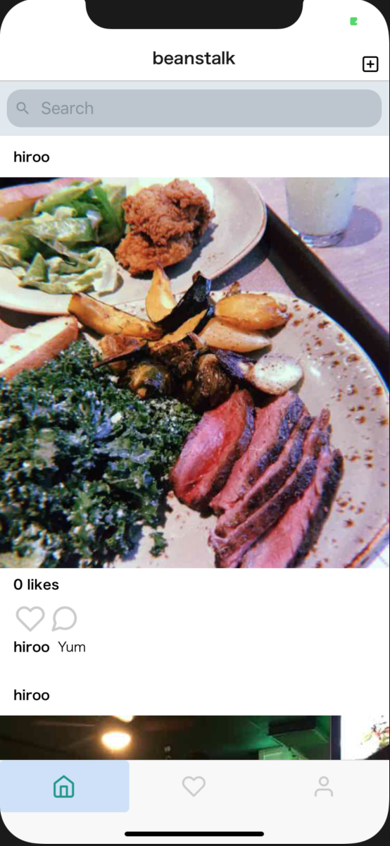
Activity Feed
Design: App:
Notes:
larger pic, want to emphasize photo more

Slide 29
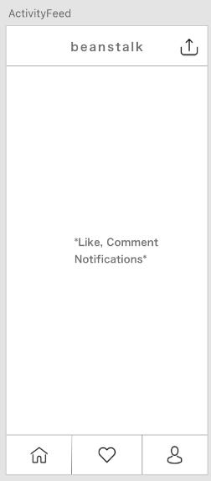
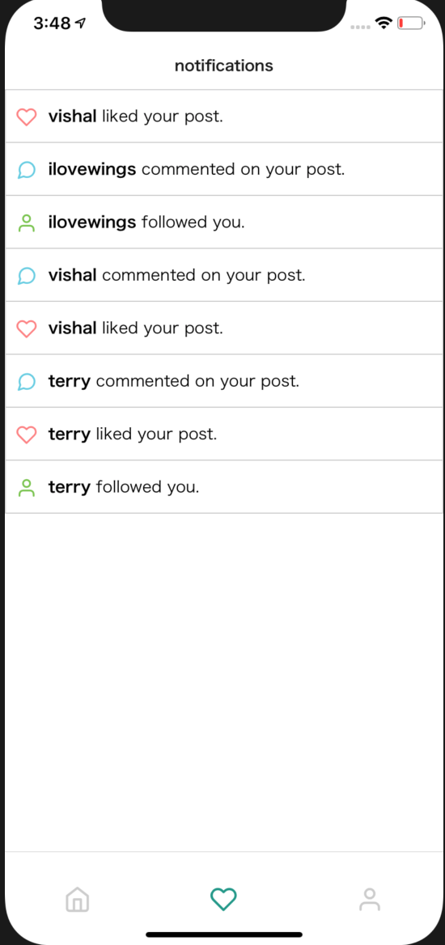
Notifications Feed
Design: App:
Notes:
larger pic, want to emphasize photo more

Slide 30
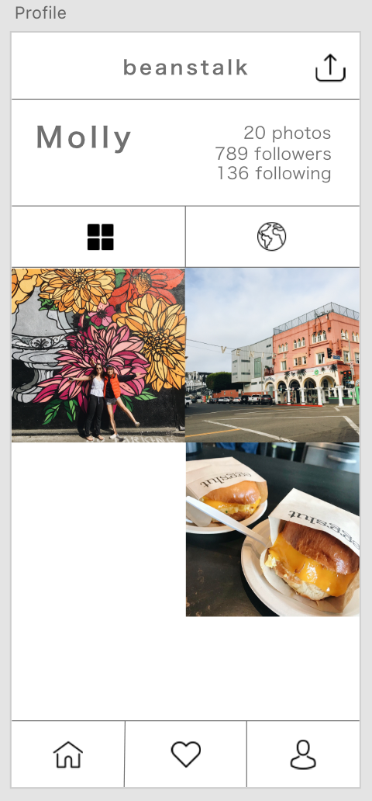
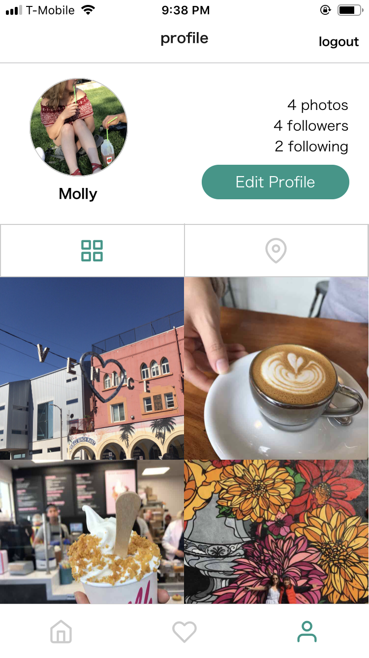
User Profile
Design: App:

Slide 31
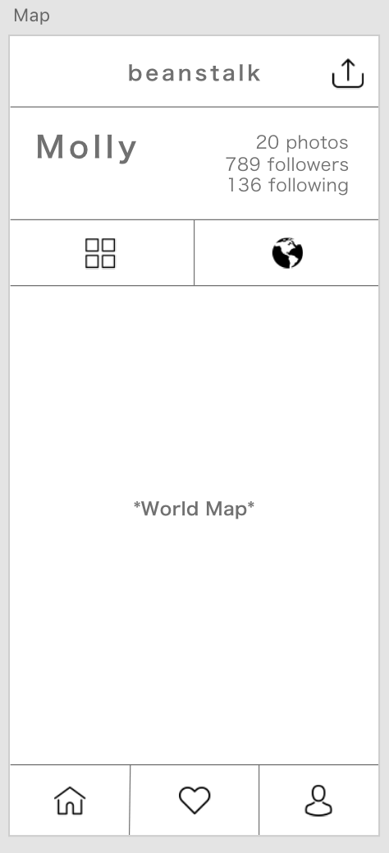
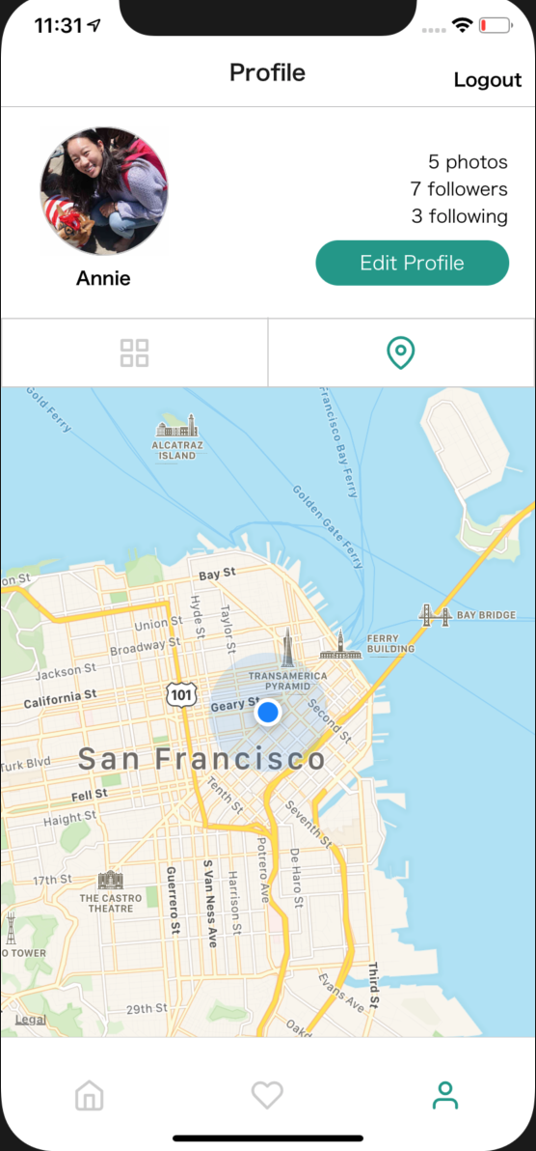
Profile Map
Design: App:

Slide 32
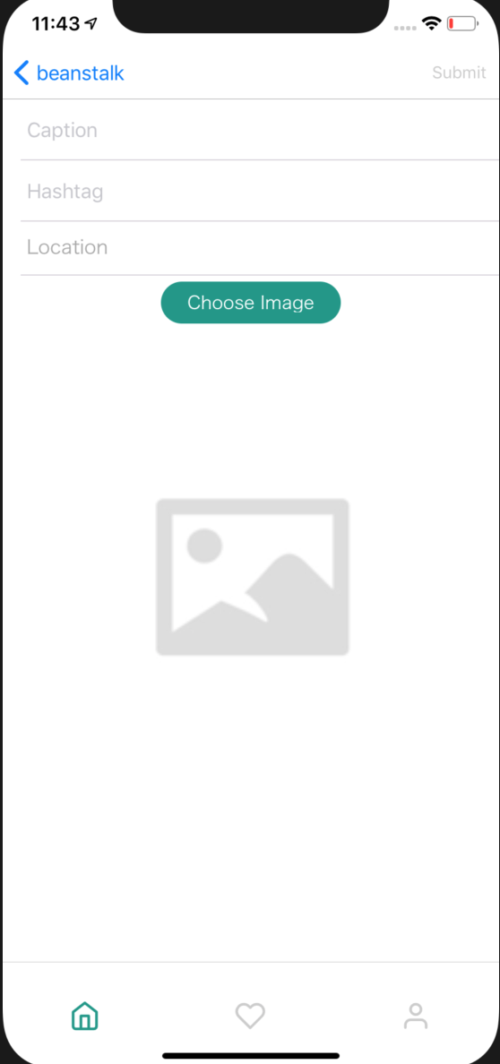
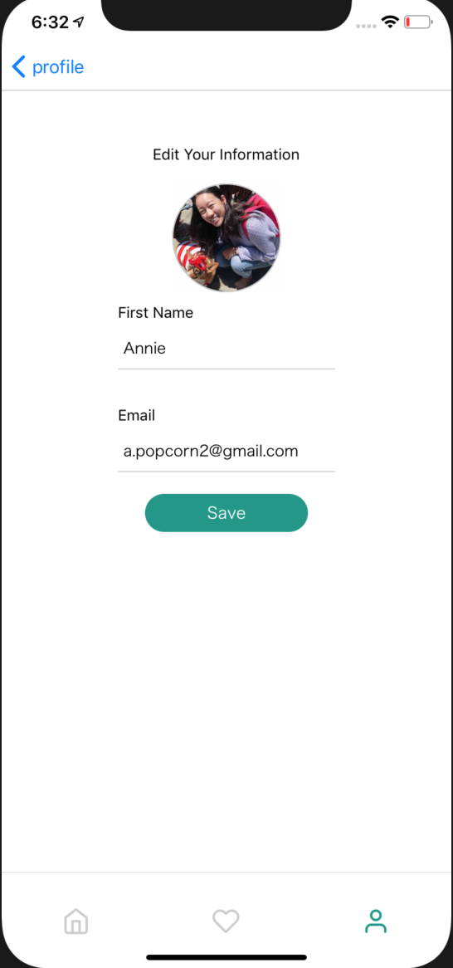
Our Additions
Create Post Page
Edit Profile Page
Notes:
add search

Slide 33
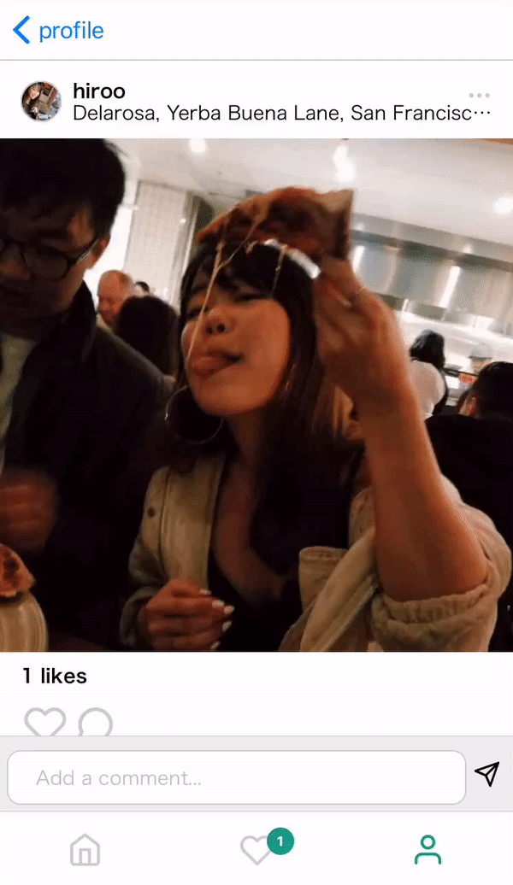
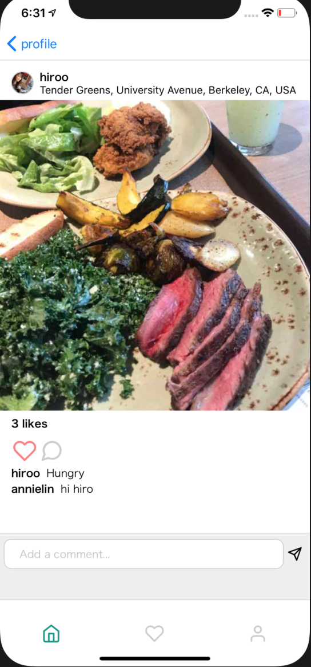
Our Additions Cont.
View Post Page
Edit Post
Notes:
add search

Slide 34
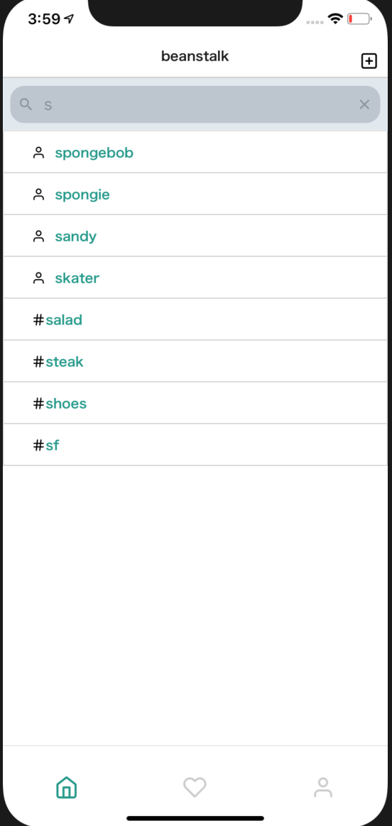
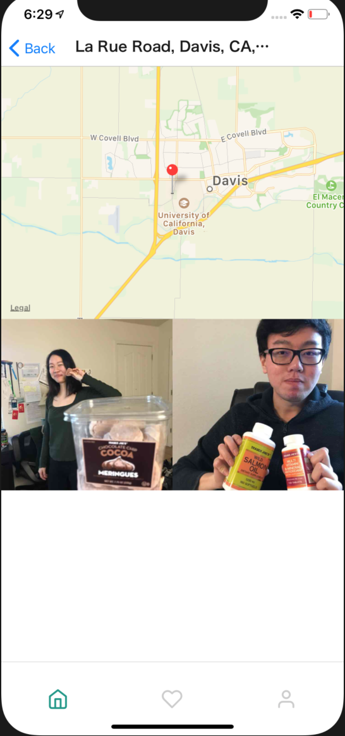
Our Additions Cont.
Search Results
Display by Hashtag
Display by Location

Slide 35
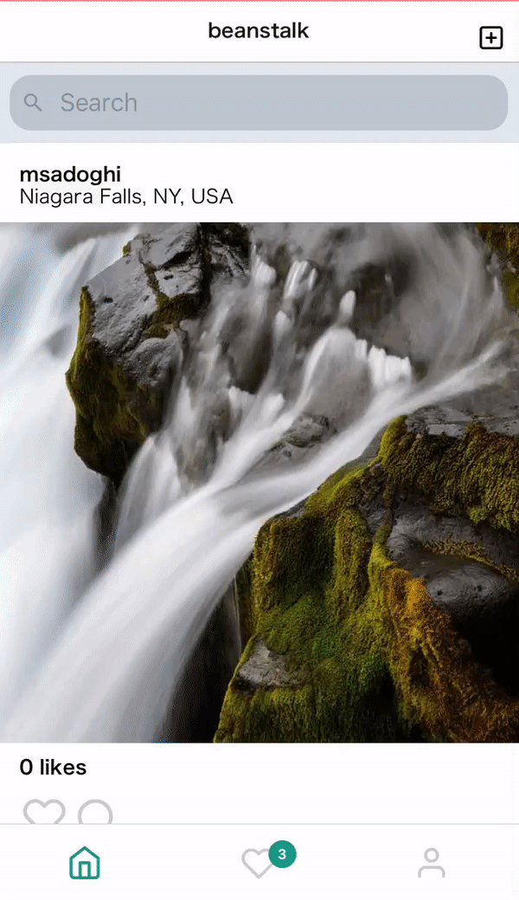
UX Features: Reset Stack
on pressing focused tab
With each navigation, a page is added onto a stack, which makes it harder to return to the original feed.
If the tab is focused and the index of stack is larger than 0, we call navigation.dispatch() which calls a defined stack reset function.

Slide 36
UX Features: PARSETEXT
showing valid hashtag
To make it easier for users to identify what is a valid/invalid hashtag, we parse the input to see if it matches the proper hashtag-string format and highlight them accordingly.
If nothing in the input matches, it will raise an error upon submission.

Slide 37
Future Features:
Wishlist
Features Wishlist
Cool Features Possibilities

Slide 38
Features Wishlist
Tagging users in photos
Displaying followers of user
Displaying users who liked post
Instant messaging between users
Disappearing stories
Categories for travels on Map
Map that aggregates all photos near your location

Slide 39
Live Demo
Hashtags Search
Notifications
Map

Slide 40
Questions?

